Slide 1
INTRODUCTION TO
ALGORITHMS
FOURTH EDITION

Slide 2
LECTURE NOTES FOR CHAPTER 20
Elementary Graph Algorithms

Slide 3
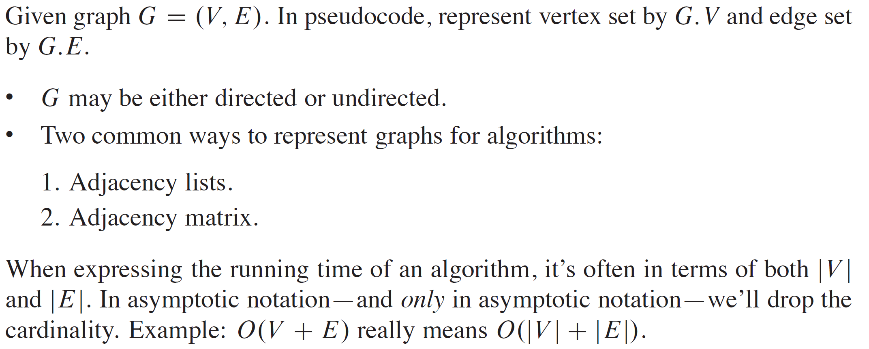
GRAPH REPRESENTATION

Slide 4
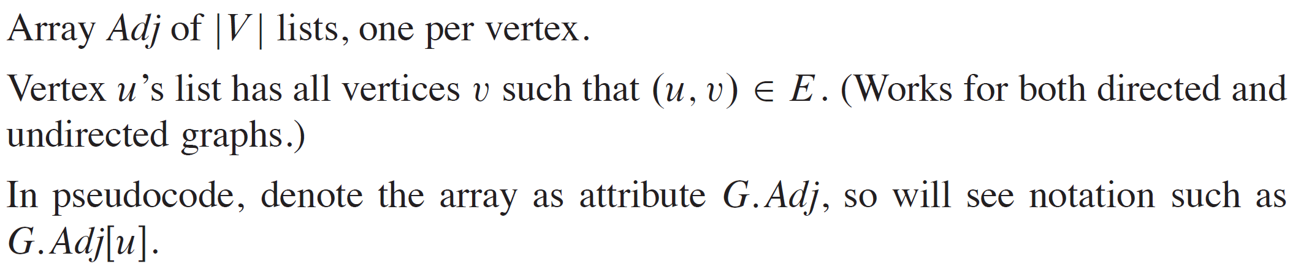
ADJACENCY LISTS

Slide 5
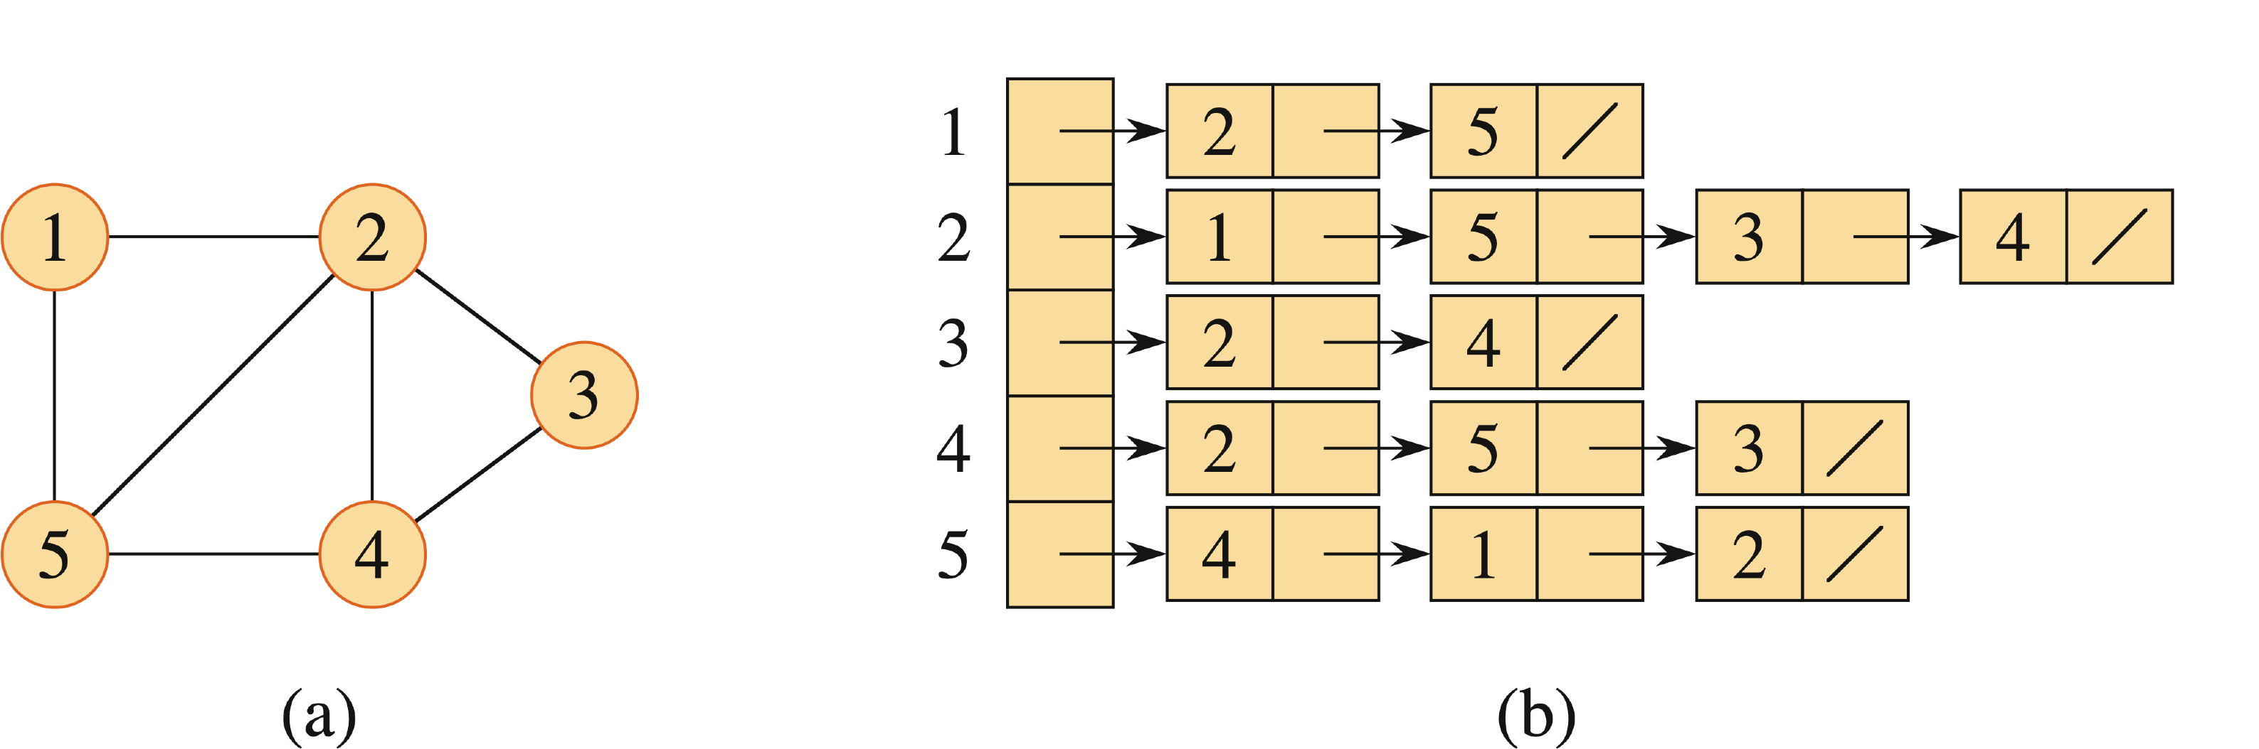
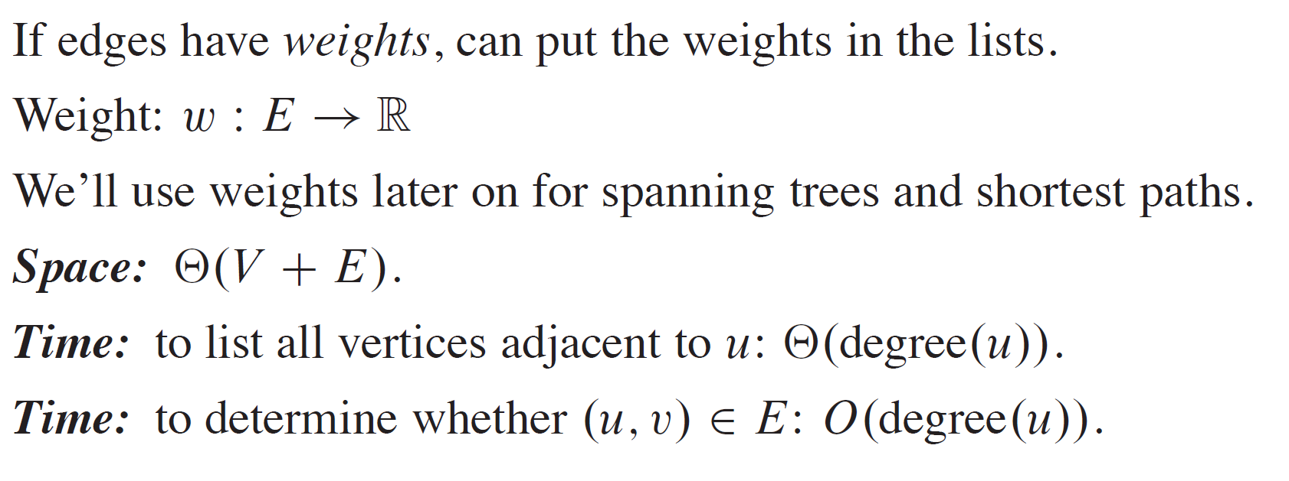
EXAMPLE
For an undirected graph:

Slide 6
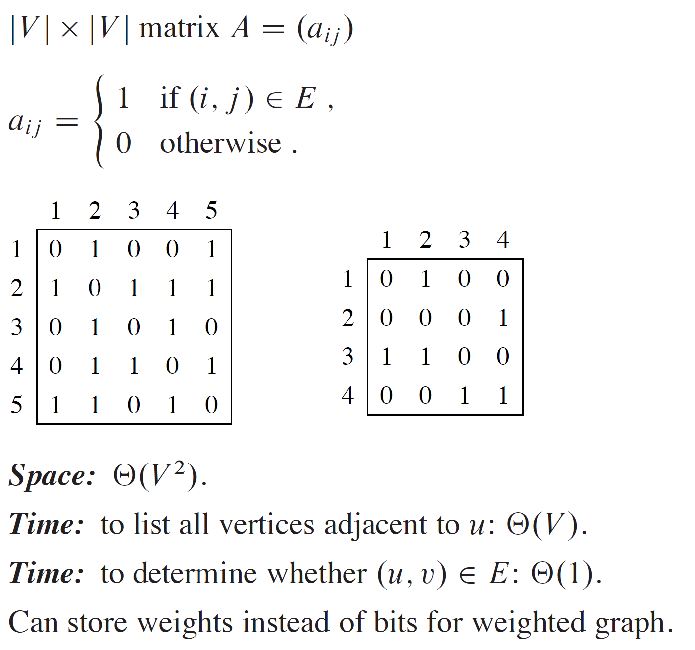
ADJACENCY MATRIX

Slide 7
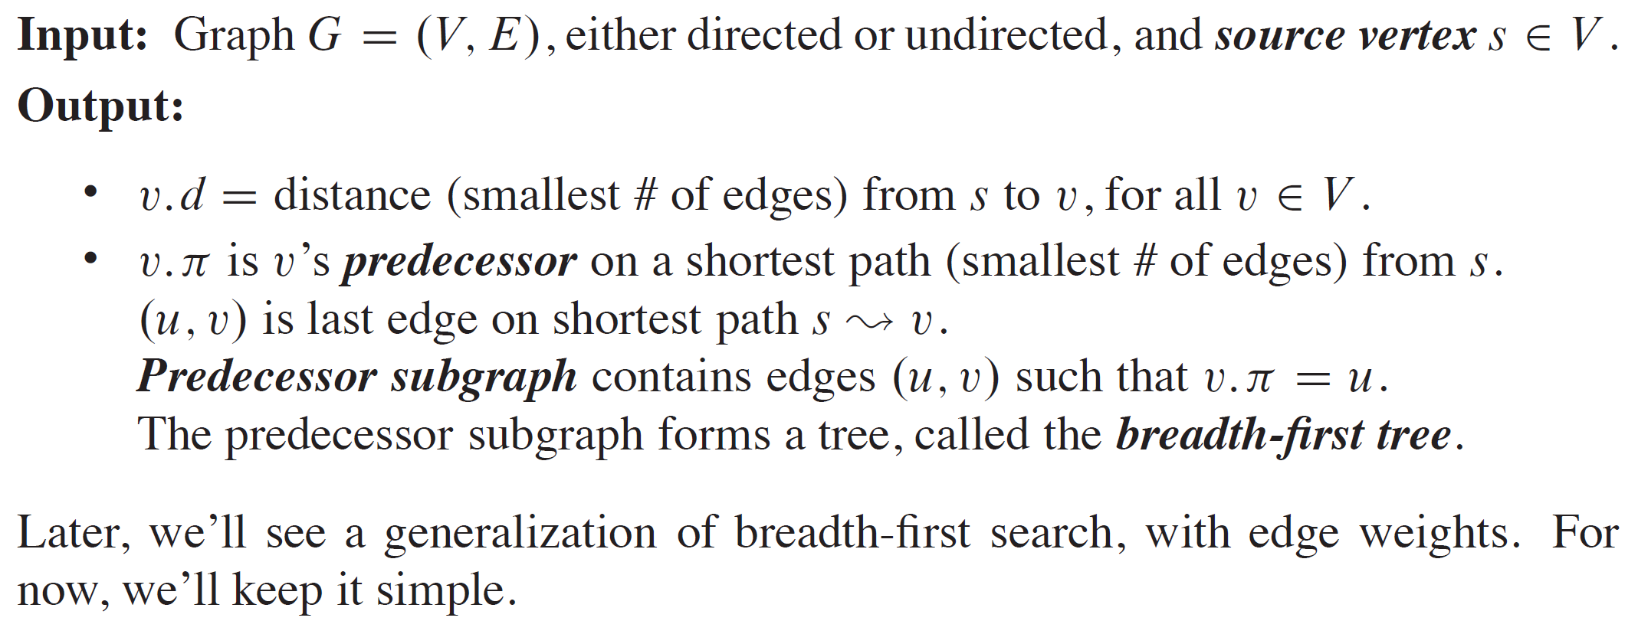
BREADTH-FIRST SEARCH

Slide 8
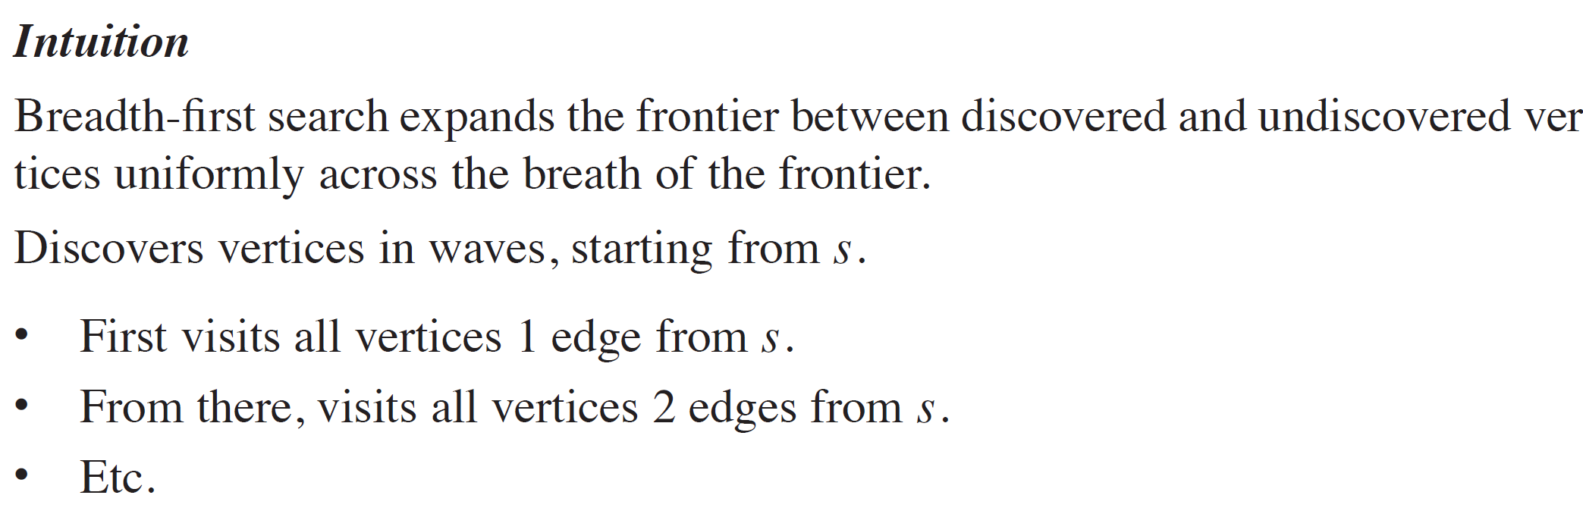
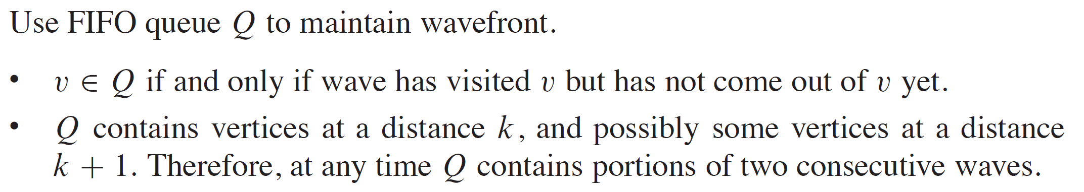
BREADTH-FIRST SEARCH (continued)

Slide 9
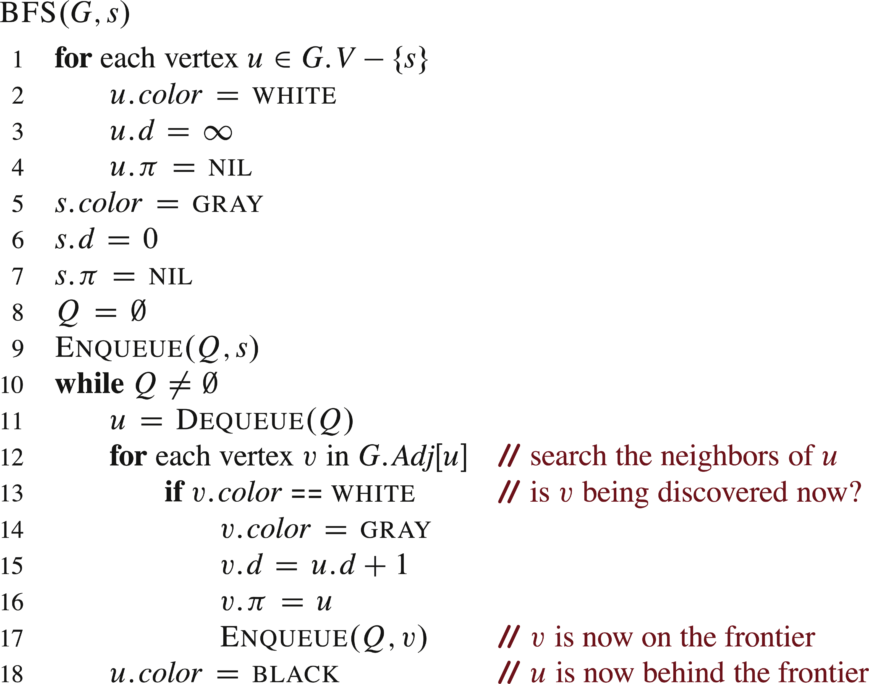
PSEUDOCODE

Slide 10
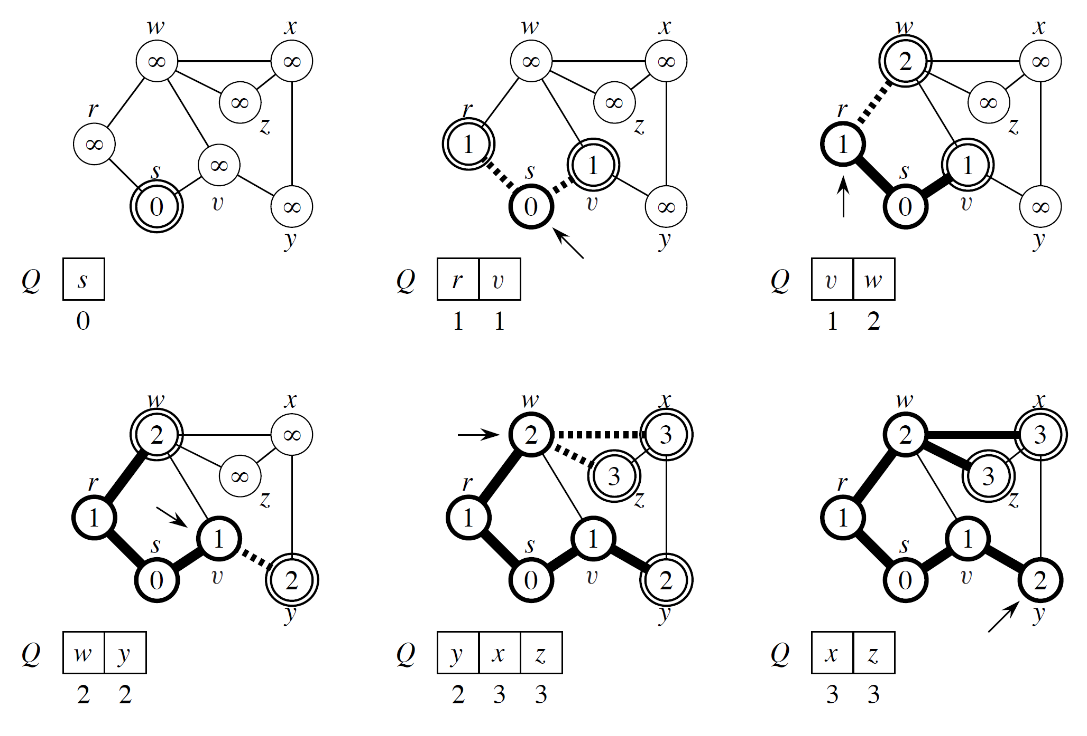
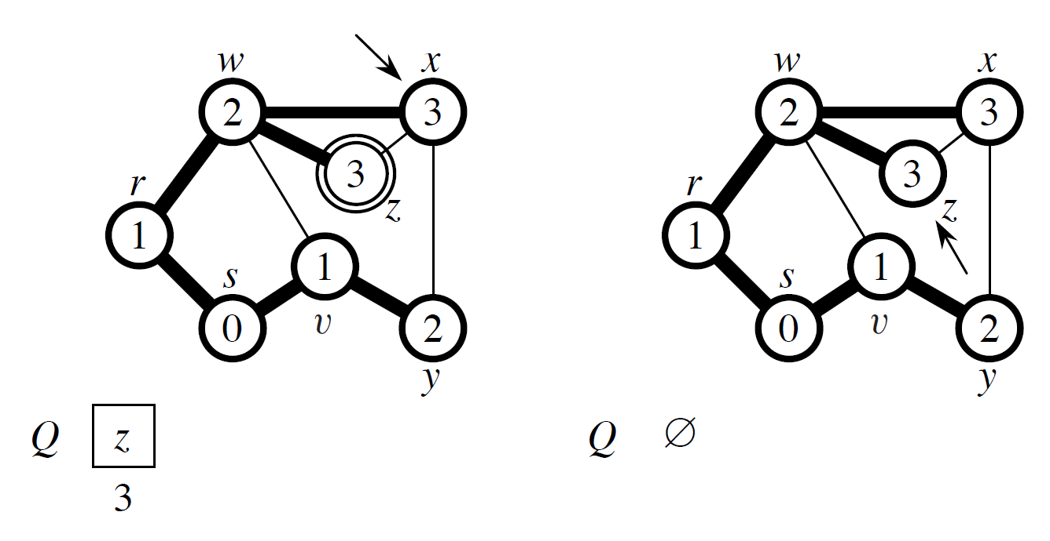
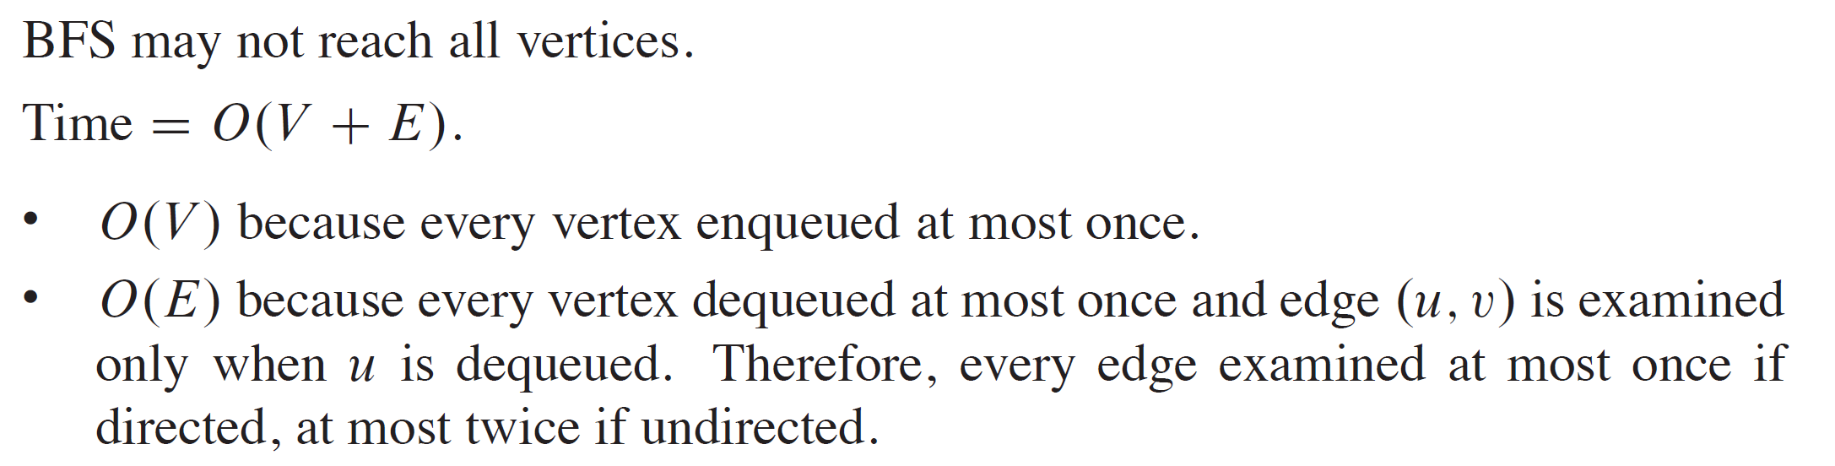
EXAMPLE
Edges drawn with heavy lines are in the predecessor subgraph.
Dashed lines go to newly discovered vertices. They are drawn with heavy lines because they are also now in the predecessor subgraph.
Double-outline vertices have been discovered and are in Q, waiting to be visited.
Heavy-outline vertices have been discovered, dequeued from Q, and visited.

Slide 11
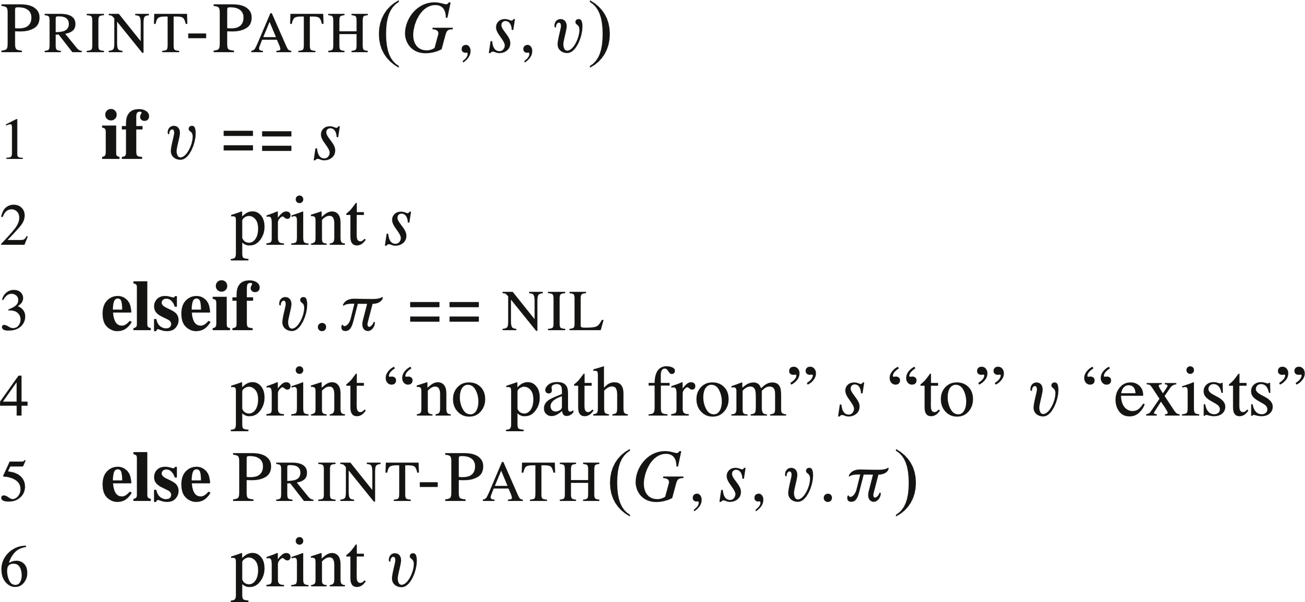
PSEUDOCODE
To print the vertices on a shortest path from s to v:

Slide 12
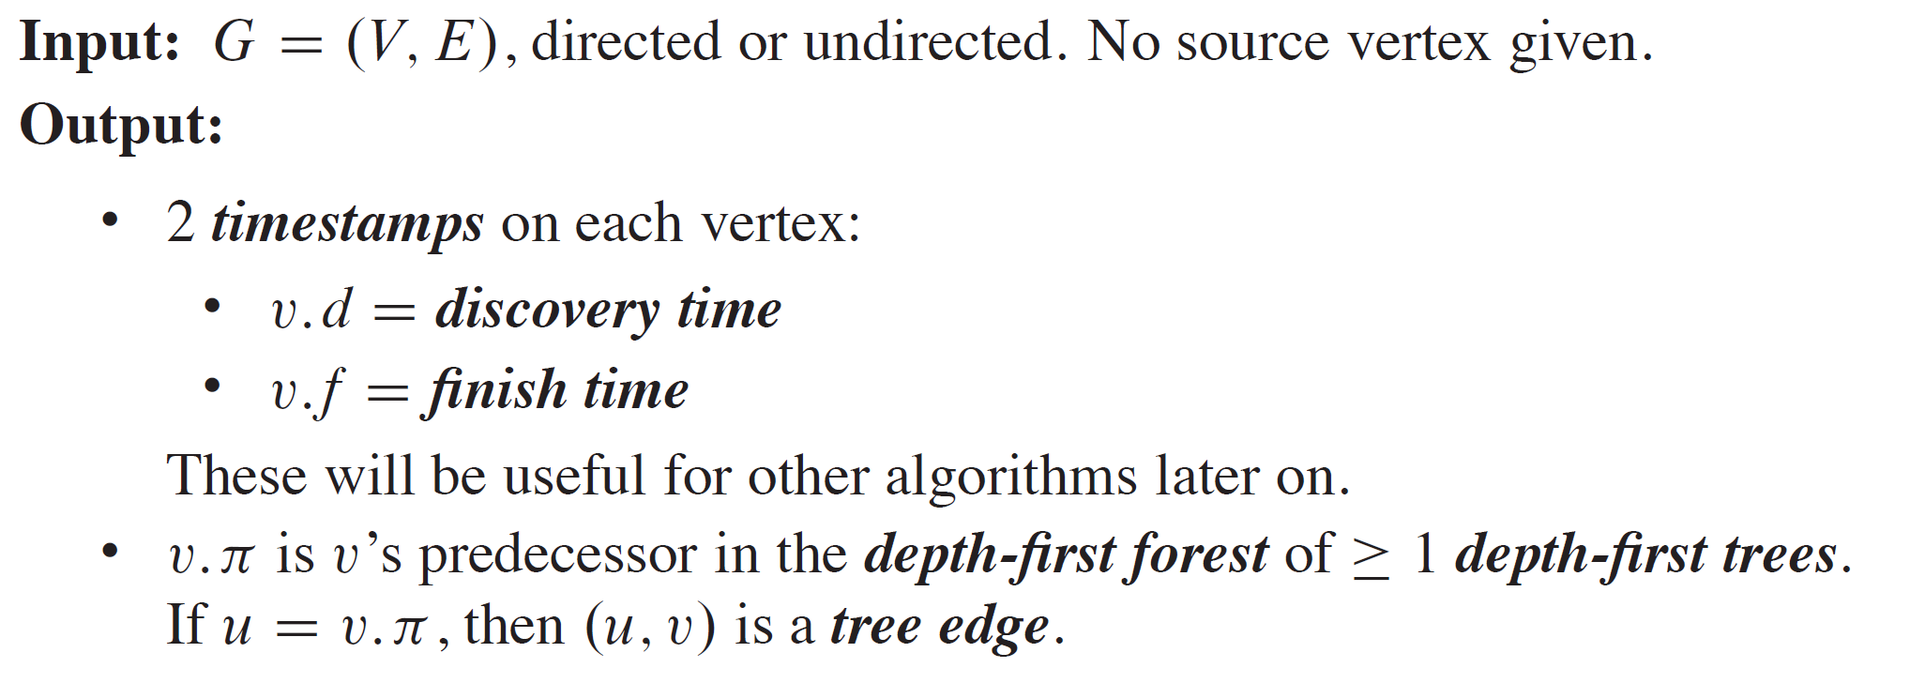
DEPTH-FIRST SEARCH

Slide 13
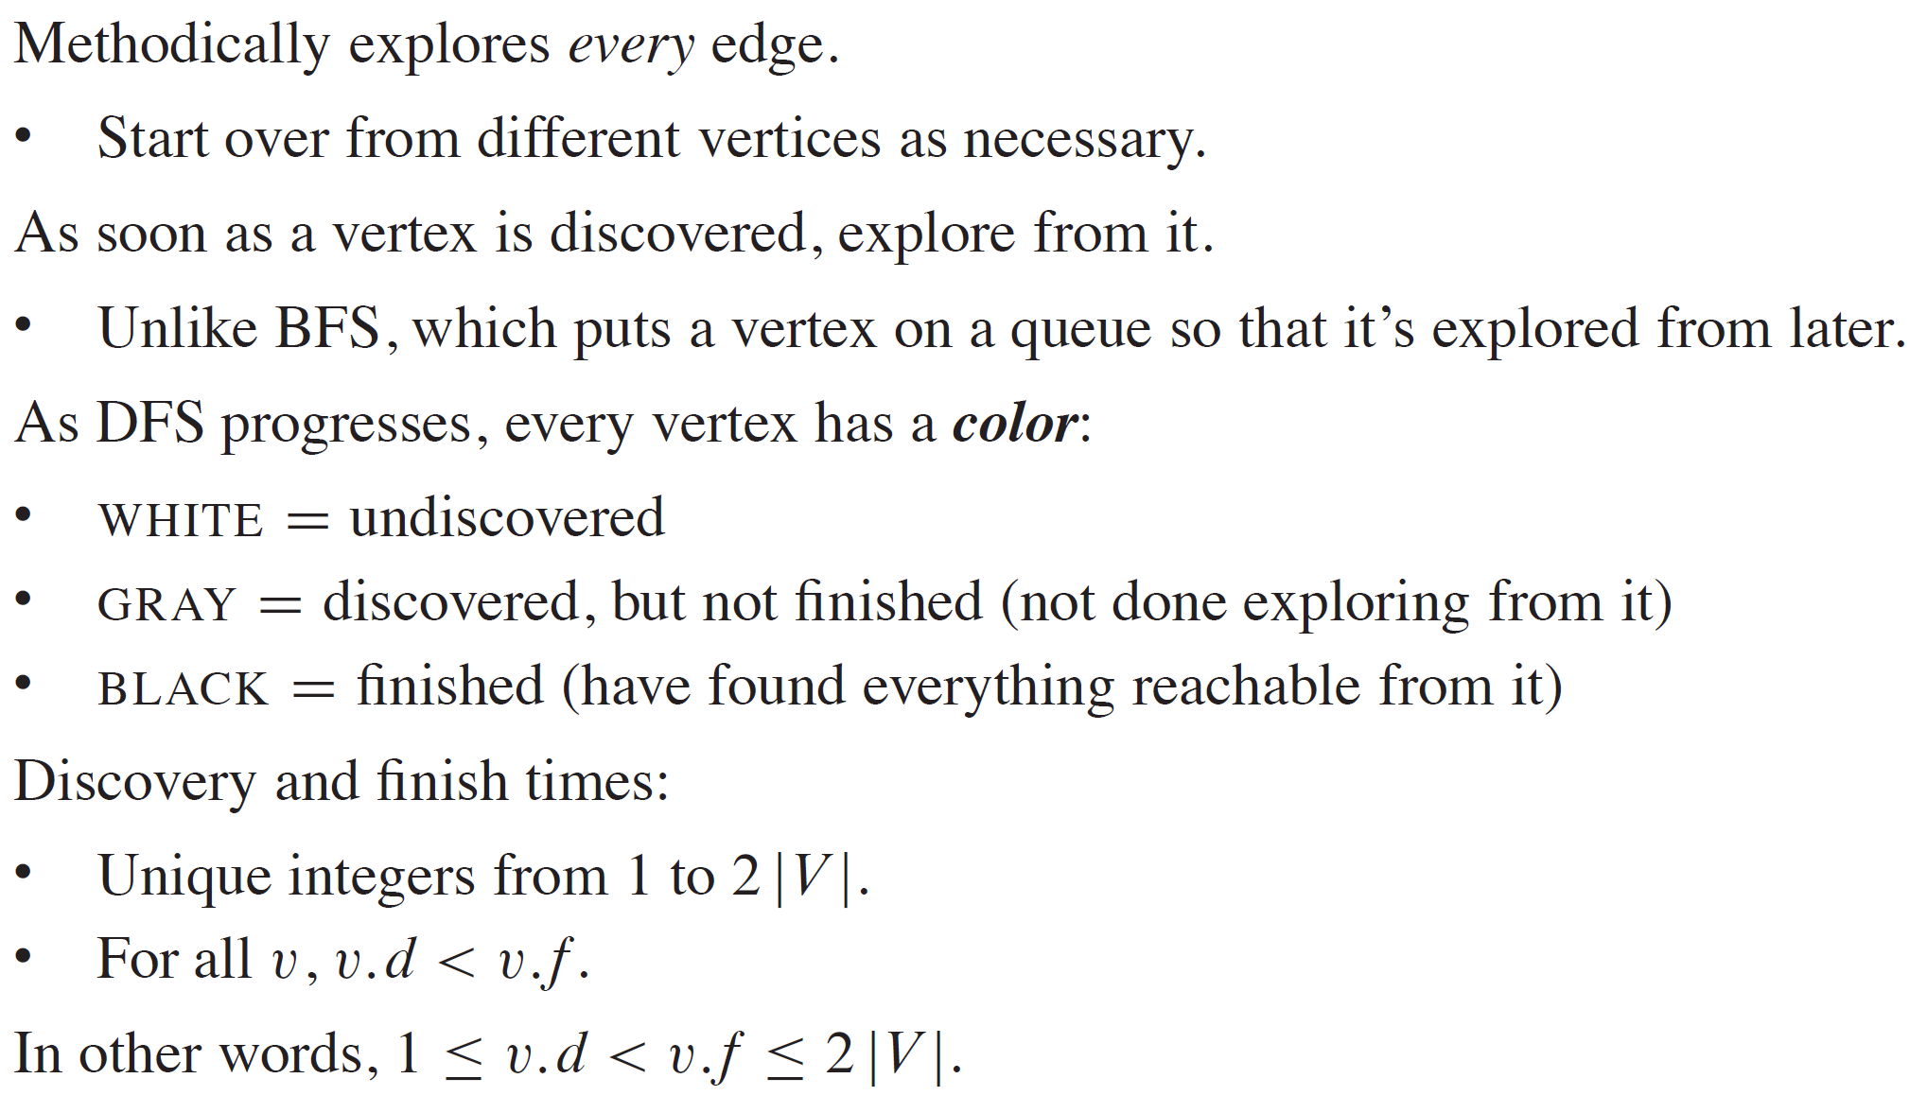
DEPTH-FIRST SEARCH (continued)

Slide 14
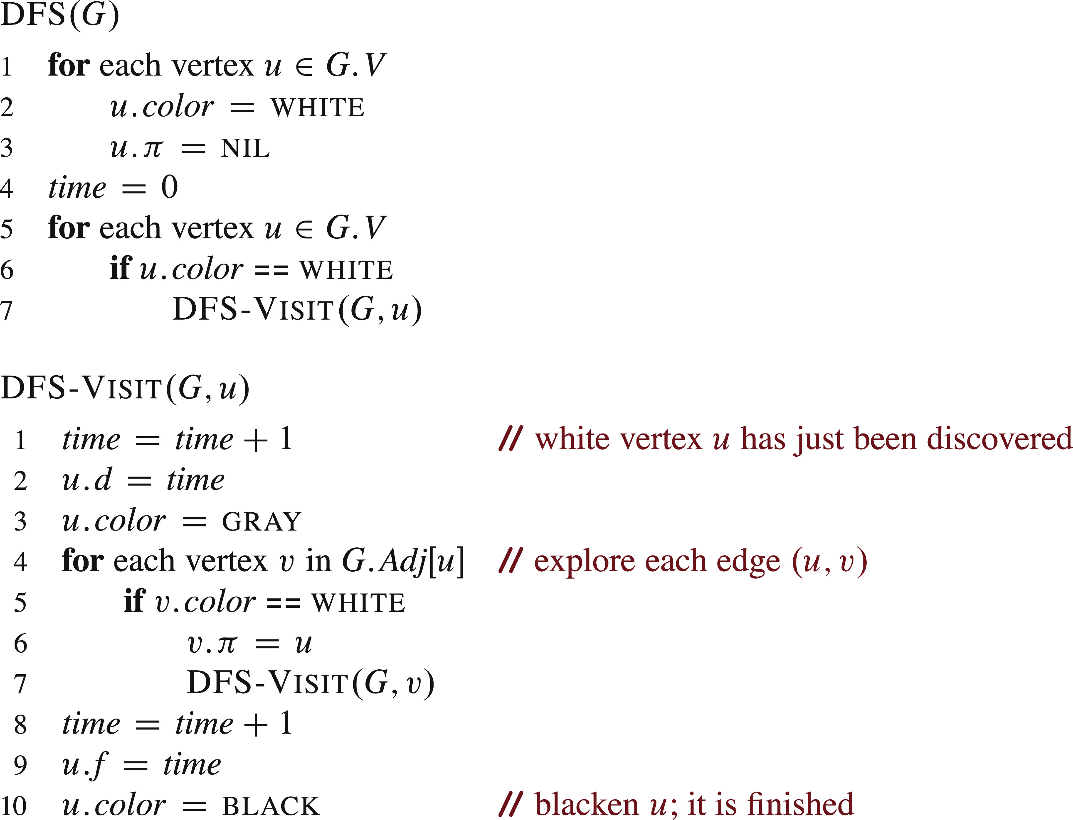
PSEUDOCODE
Global search starts a local search on each vertex to explore entire graph.

Slide 15
PSEUDOCODE (continued)

Slide 16
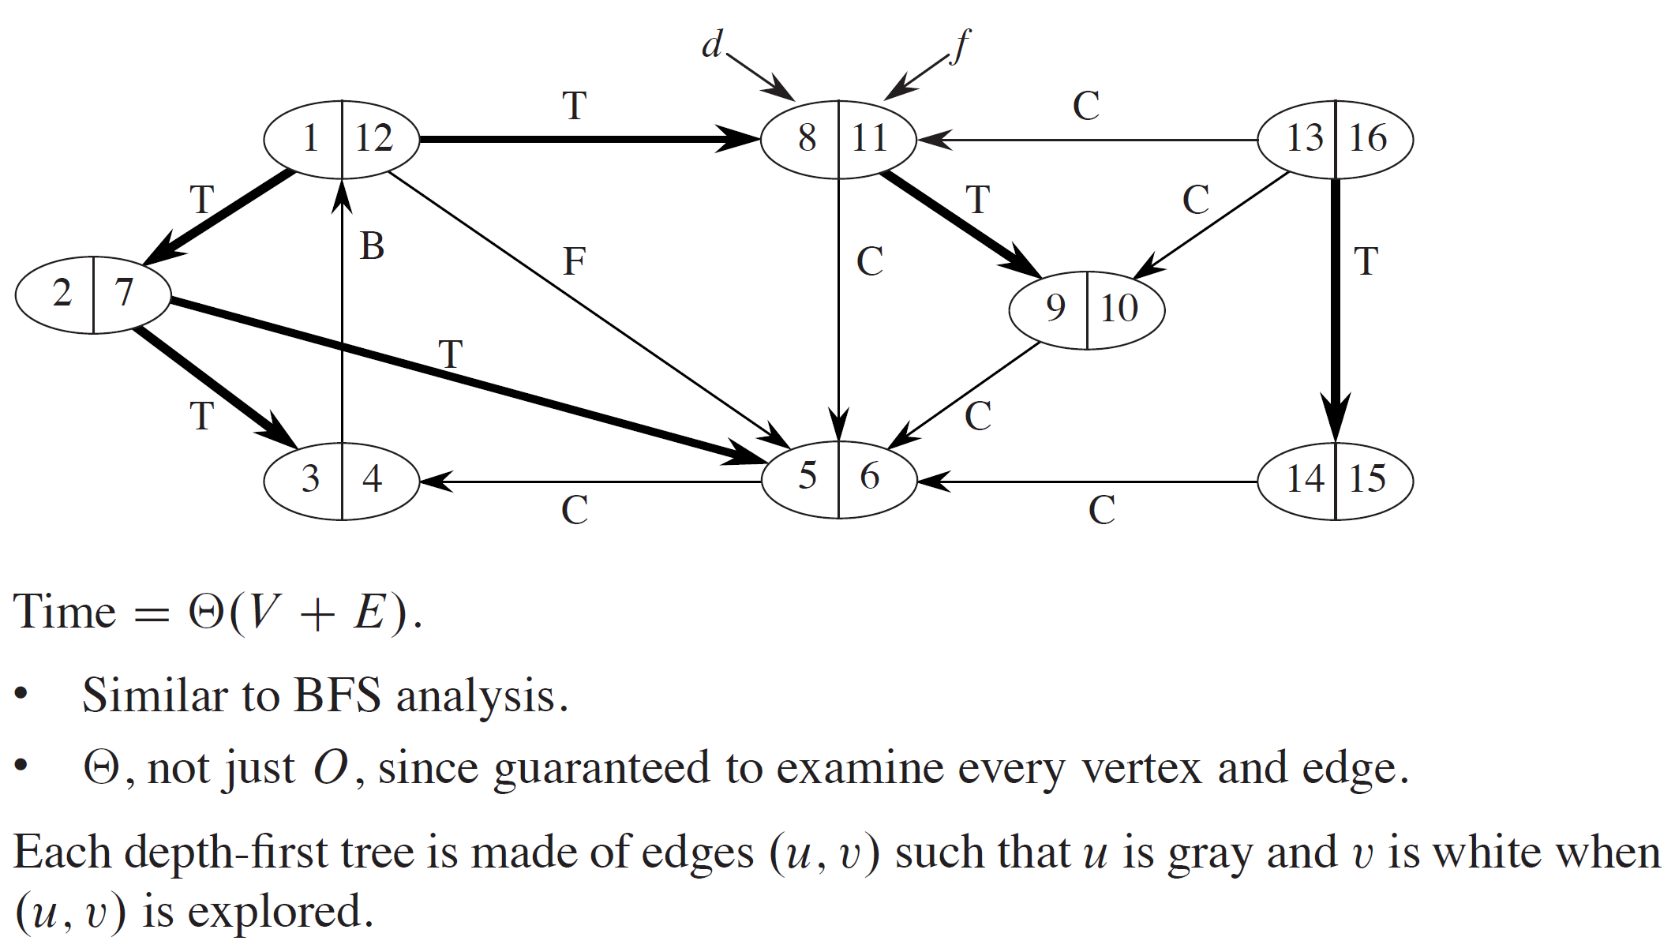
EXAMPLE

Slide 17
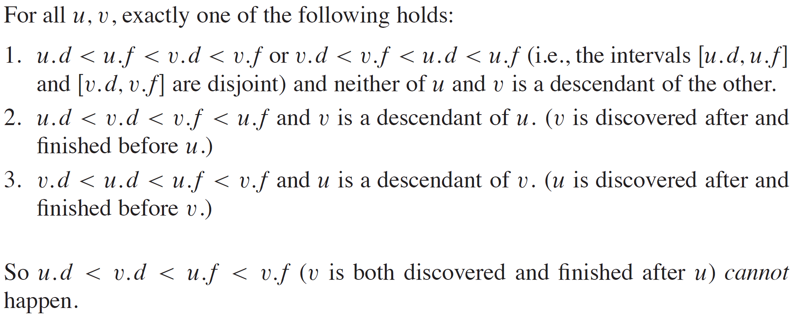
THEOREM (PARENTHESIS THEOREM)

Slide 18
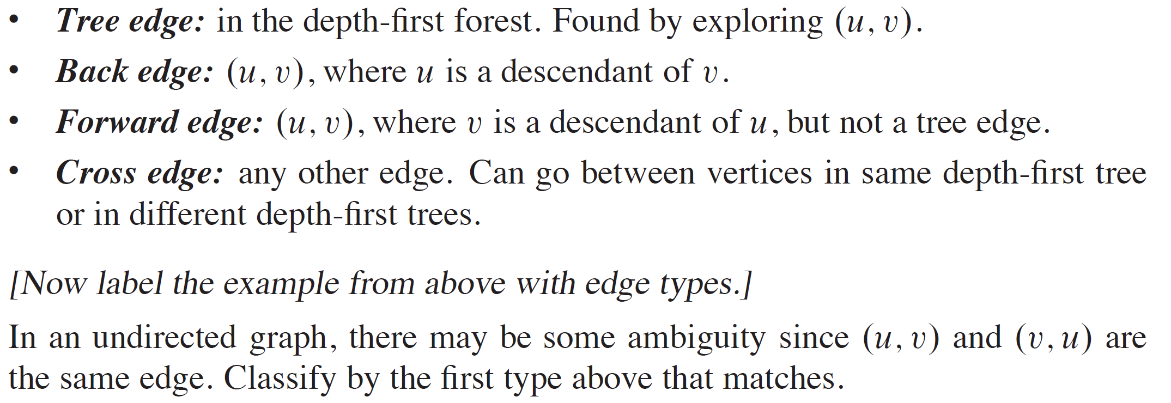
CLASSIFICATION OF EDGES

Slide 19
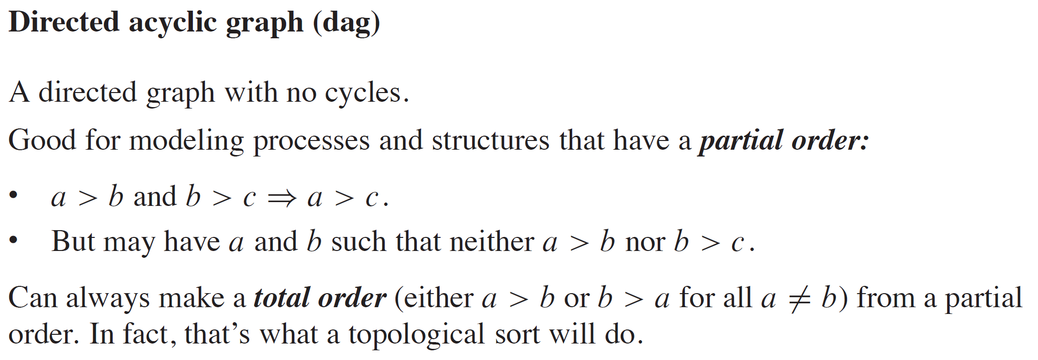
TOPOLOGICAL SORT

Slide 20
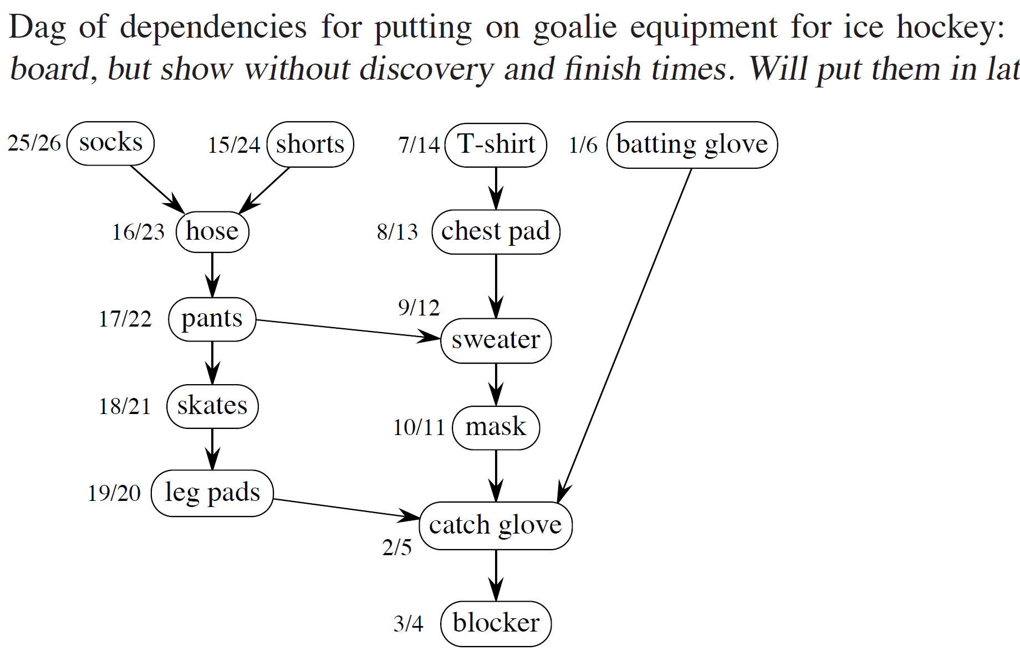
EXAMPLE

Slide 21
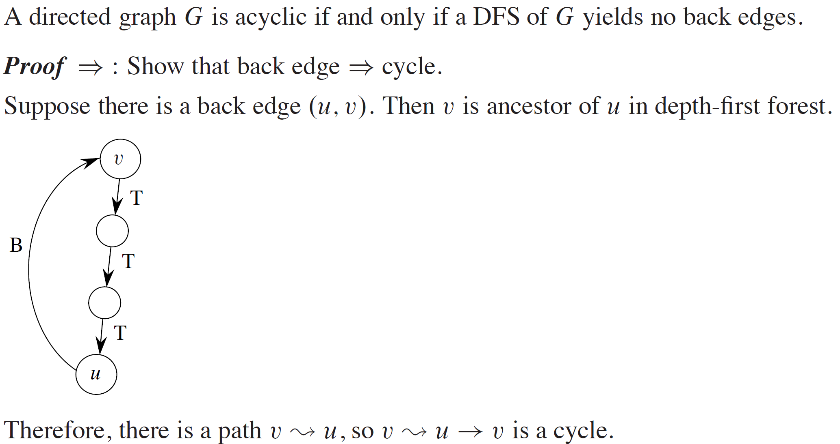
EXAMPLE (continued)

Slide 22
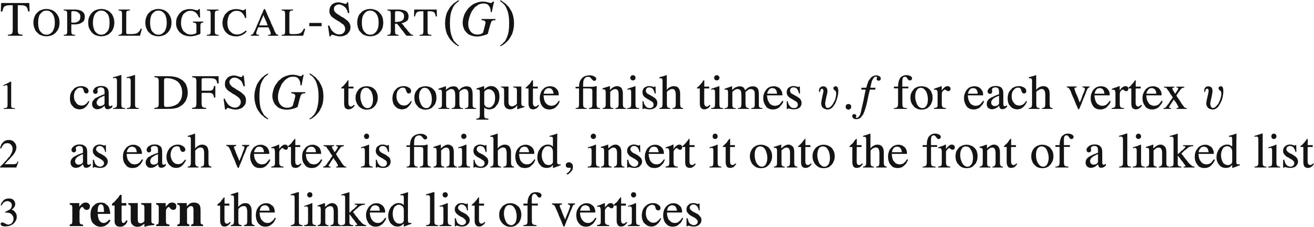
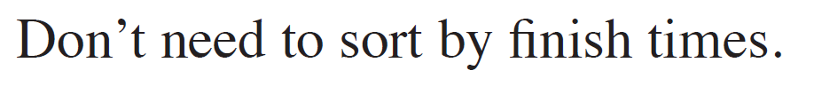
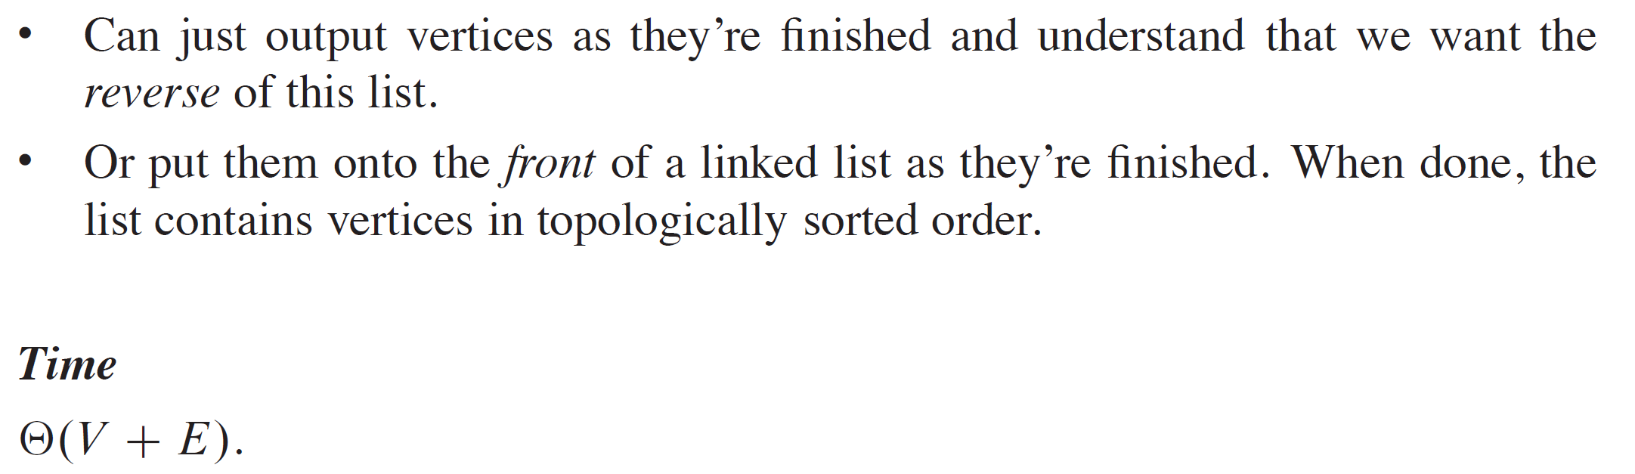
EXAMPLE (continued)

Slide 23
EXAMPLE (continued)
Let’s run DFS on this example to find finish times.

Slide 24
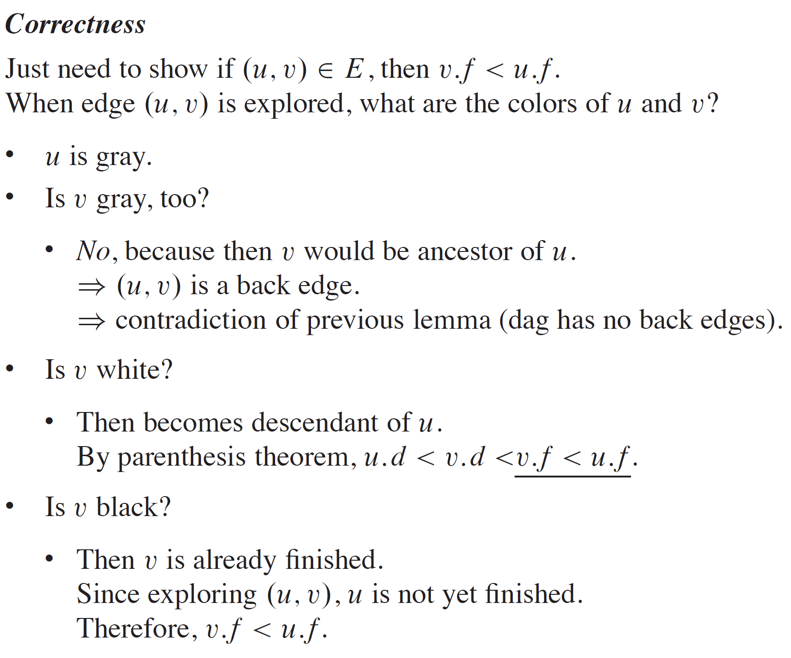
EXAMPLE (continued)

Slide 25
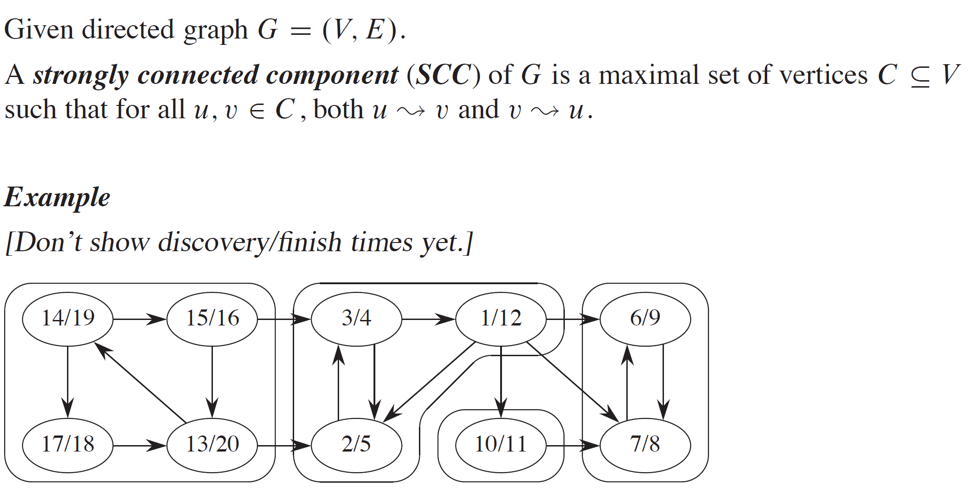
STRONGLY CONNECTED COMPONENTS

Slide 26
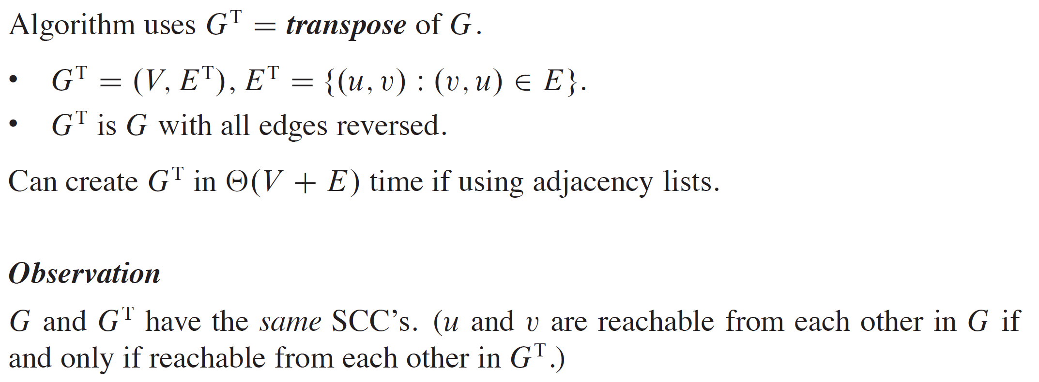
EXAMPLE (continued)

Slide 27
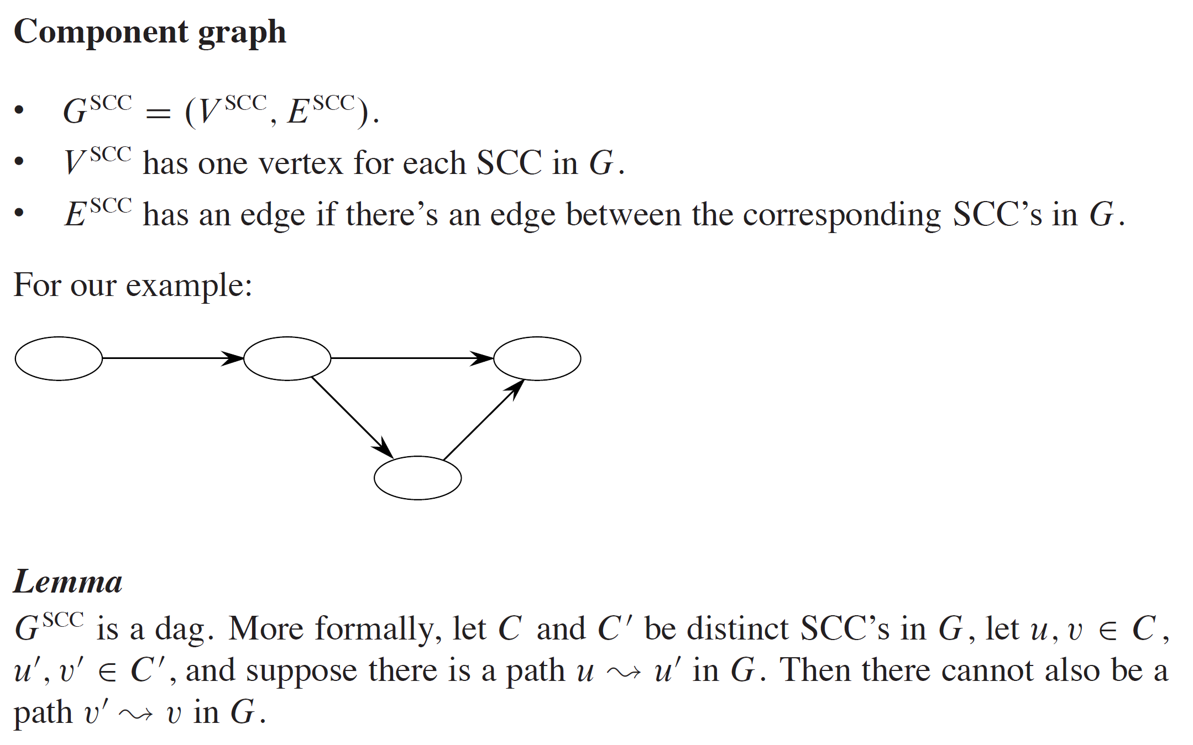
EXAMPLE (continued)

Slide 28
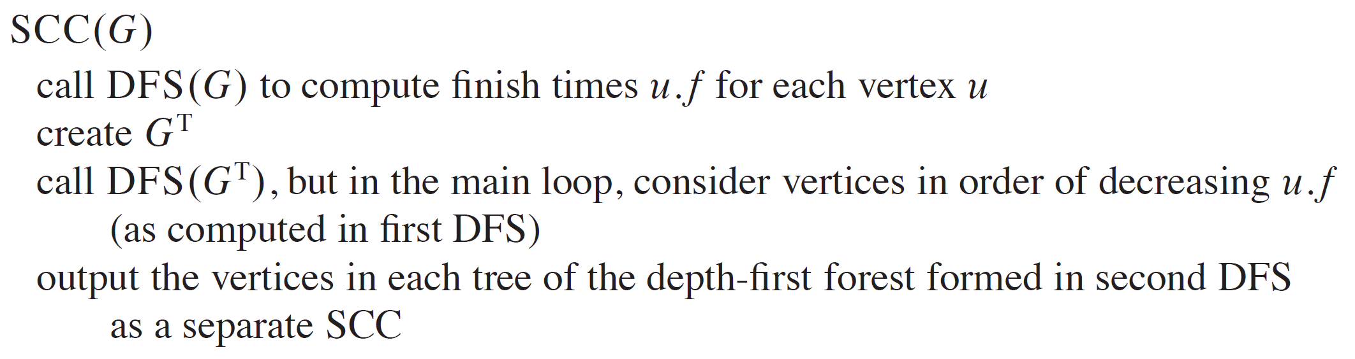
EXAMPLE (continued)
Do DFS in G.

Slide 29
EXAMPLE (continued)
Run DFS.

Slide 30
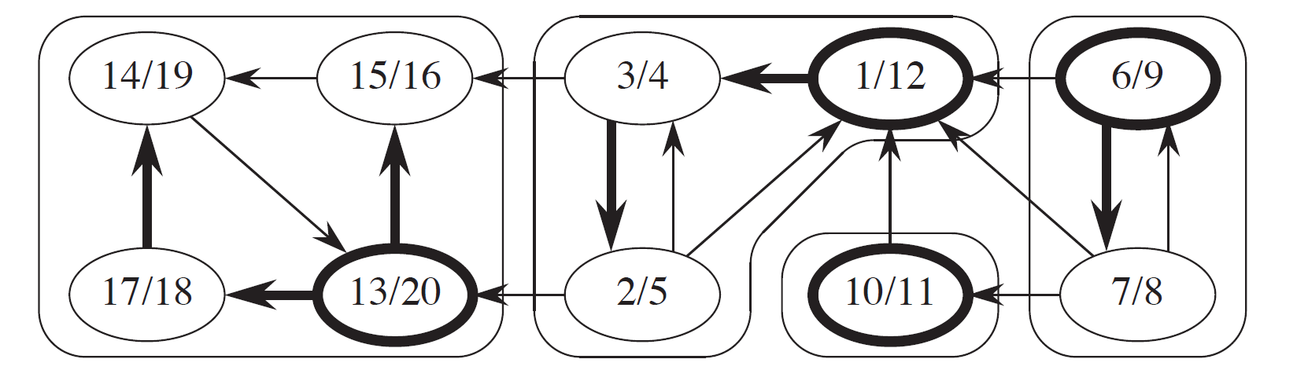
EXAMPLE (continued)
Take G^{T}.

Slide 31
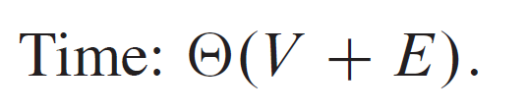
EXAMPLE (continued)
DFS in G^{T}.
Each top level DFS-Visit will discover it’s component.

Slide 32
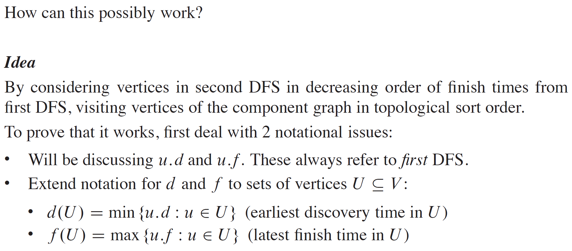
EXAMPLE (continued)

Slide 33
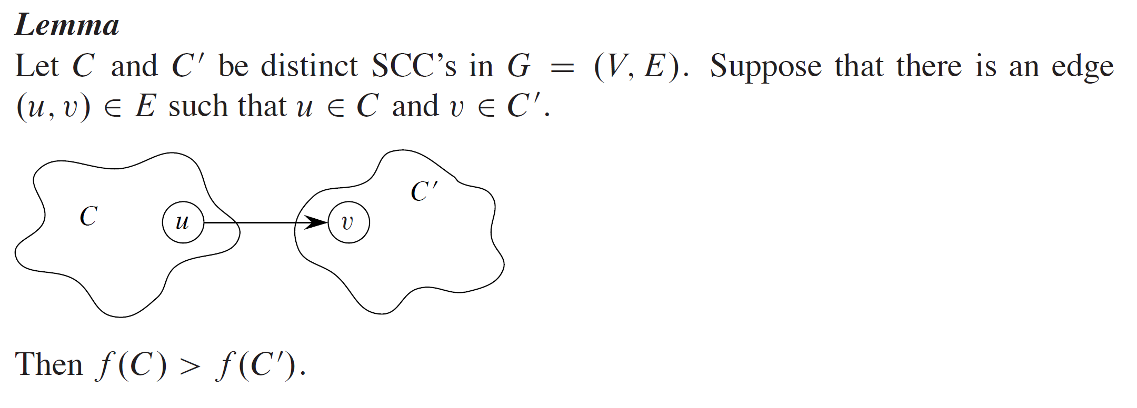
EXAMPLE (continued)

Slide 34
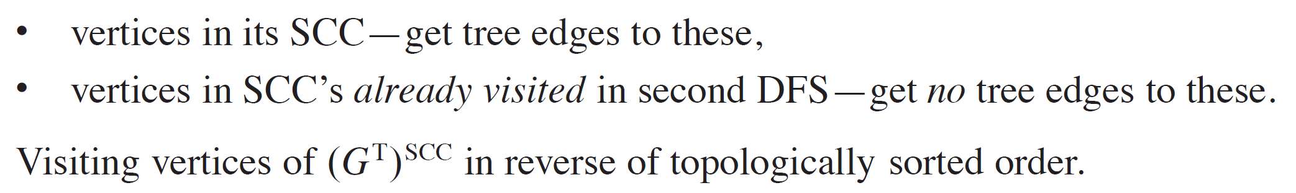
STRONGLY CONNECTED COMPONENTS

